Slide 1
Ch 2 Probability
Dr. Michael Nasief

Slide 2
Introduction
Mathematics
Measure Theory
Probability Theory
Random Process theory

Slide 3
Introduction
Probability Theory Vs Measure Theory
Both
Concentrate on functions that assign real numbers to sets in the abstract space according to certain rules.
Consider only non negative real valued set functions ( value = measure or probability)

Slide 4
Introduction
Probability Theory Vs Measure Theory
Difference
Probability assigns the value of 1 to all sets ( the entire abstract space)
Means:
Abstract space contains every possible outcome of an experiment or probability = 1
But subsets of space have some un certainty or probability < 1

Slide 5
Probability theory Basic Concept
Probability Space= Experiment
Abstract Space Ω= Sample Space
Event Space F
Probability Measure

Slide 6
Probability theory Basic Concept
An abstract space Ω,
called a sample space, which contains all distinguishable elementary outcomes or results of an experiment.
These points might be names, numbers, or complicated signals.

Slide 7
Probability theory Basic Concept
An event space or sigma- field F
consisting of a collection of subsets of the abstract space which we wish to consider as possible events and to which we wish to assign a probability.
operations (union, intersection, complementation, deference , symmetric deference) on events must produce other events.

Slide 8
Probability theory Basic Concept
A probability measure P
an assignment of a number between 0 and 1 to every event, that is, to every set in the event space.

Slide 9
Signal Processing
If ω ∈ Ω (Sample Space)
ω can be viewed as a signal
Voltage
Vector of values
Sequence of values
Waveforms
Any measured signal
Any received signal
Or any sensed signal
Signal processing = operations on signal
Ex g(ω)

Slide 10
Signal Processing
Signal processing and probability
If we have a probabilistic description of the underlying experiment, then we should be able to derive a probabilistic description of the outcome of the signal processor

Slide 11
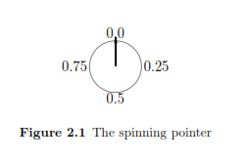
A uniform spinning pointer
When the pointer stops it can point to any number in the unit interval
[0, 1) = {r : 0 ≤ r < 1}.
We call [0, 1) the sample space of our experiment and denote it by a capital Greek omega, Ω.

Slide 12
A uniform spinning pointer
“the pointer points to a number between 0.0 and 0.5” (which one would expect should have probability 0.5 if the wheel is indeed fair
We can formalize this by stating that for any interval
[a, b] = {r : a ≤ r ≤ b} with 0 ≤ a ≤ b < 1
we have that the probability of the event “the pointer lands in the interval [a, b]” is
P([a, b]) = b − a.

Slide 13
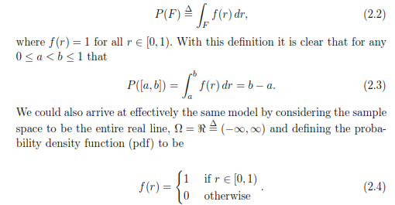
A uniform spinning pointer
defining the probability P(F)

Slide 14
A uniform spinning pointer

Slide 15
A uniform spinning pointer

Slide 16
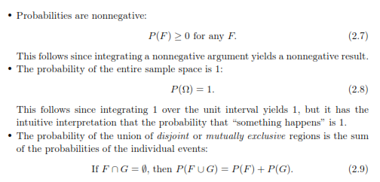
A uniform spinning pointer
Three Important Rules:
Non negative – Normalization - Additive

Slide 17
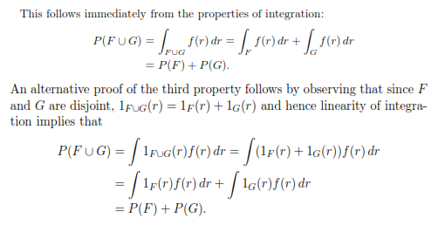
A uniform spinning pointer

Slide 18
A uniform spinning pointer

Slide 19
A uniform spinning pointer
Simple Properties

Slide 20
A uniform spinning pointer

Slide 21
Note
Observe that although the null or empty set ∅ has probability 0, the converse is not true in that a set need not be empty just because it has zero probability.

Slide 22
A single coin flip (Discrete)
The sample space in this example is
Ω = {0, 1}
and the probability for any event or subset of Ω can be defined in a reasonable way by

Slide 23
Definition of pmf
where now p(r) = 1/2 for each r ∈ Ω.
The function p is called a probability mass function or pmf because it is summed over points to ﬁnd total probability.
Be cautioned that P is deﬁned for sets and p is deﬁned only for points in the sample space. This can be confusing when dealing with one-point or singleton sets, for example
P({0}) = p(0)
P({1}) = p(1).

Slide 24
A single coin flip (Discrete)
A single coin flip as signal processing
This is an example of a quantizer , an operation that maps a continuous value into a discrete value. Quantization is an example of signal processing

Slide 25
Abstract Versus Concrete
Physical intuition says that the probability tells you something about the fraction of times specific events will occur in a sequence of trials,
suppose the output of the nth trial of a sequence of trials is xn and we wish to know the relative frequency that xn takes on a particular value, say a.

Slide 26
Abstract Versus Concrete
Example:
For example, the relative frequency of heads in an infinite sequence of fair coin ﬂips should be 0.5,
and the relative frequency of rolling a pair of fair dice and having the sum be 7 in an infinite sequence of rolls should be 1/6 since
the pairs (1, 6), (6, 1), (2, 5), (5, 2), (3, 4), (4, 3) are equally likely and form 6 of the possible 36 pairs of outcomes.

Slide 27
Abstract Versus Concrete
Relative frequencies are nonnegative.
The relative frequency of the entire set of possible outcomes is one.
and relative frequencies are additive in the sense that the relative frequency of the symbol a or the symbol b occurring, ra∪b (x), is clearly ra(x) + rb(x).

Slide 28
Probability Space
A sample space Ω is an abstract space, a nonempty collection of points or members or elements called sample points (or elementary events or elementary outcomes).
An event space (or sigma-ﬁeld or sigma-algebra) F of a sample space Ω is a nonempty collection of subsets of Ω called events with the following three properties:

Slide 29
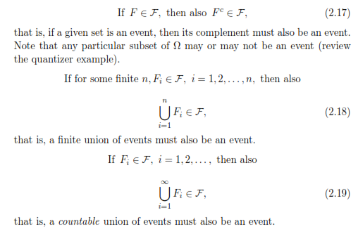
Probability Space

Slide 30
Probability Space

Slide 31
Probability Space
A measurable space (Ω, F) is a pair consisting of a sample space Ω and an event space or sigma-ﬁeld F of subsets of Ω.
A probability measure P on a measurable space (Ω, F) is an assignment of a real number P(F) to every member F of the sigma-ﬁeld (that is, to every event) such that P obeys the following rules, which we refer to as the
axioms of probability.

Slide 32
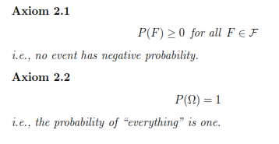
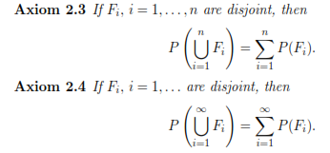
axioms of probability.

Slide 33
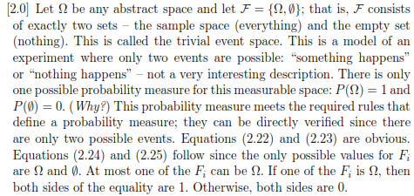
Example

Slide 34
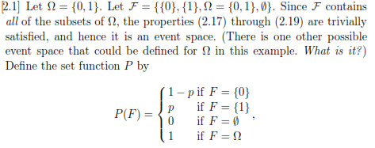
Example

Slide 35
the use of the probability theory in communications Report

Slide 36
Sample spaces Examples

Slide 37
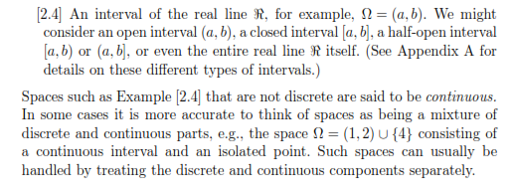

Slide 38
More about Event Space
an event space is a collection of subsets of the sample space or groupings of elementary events which we shall consider as physical events and to which we wish to assign probabilities. Mathematically, an event space
is a collection of subsets that is closed under certain set-theoretic operations;
that is, performing certain operations on events or members of the event space must give other events.

Slide 39
The countable infinite version of DeMorgan’s “laws” of elementary set theory requires that if Fi , i = 1, 2, . . . , are all members of a sigma-ﬁeld, then so is

Slide 40
Limits of sets
the limit of an increasing sequence of sets can be defined as the union of all of the sets in the sequence since the union contains all of the points in all of the sets in the sequence
and does not contain any points not contained in at least one set (and hence an infinite number of sets) in the sequence:

Slide 42
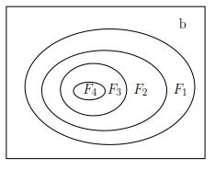
Decreasing

Slide 43
Ch 3
Random Variables, Vectors and Processes

Slide 44
Random Variables
The name random variable suggests a variable that takes on values randomly.
observer who is measuring the amount of noise on a communication link sees a random variable in this sense.
Mathematically a random variable is neither random nor a variable – it is just a function , but for the moment we informally define a random variable as a function.

Slide 45
A random variable is perhaps best thought of as a measurement on a probability space; that is, for each sample point ω the random variable produces some value, denoted functionally as f(ω). One can view ω as the result of some experiment and f(ω) as the result of a measurement made on the experiment, as in the example of the simple binary quantizer

Slide 46
The experiment outcome ω is from an abstract space, e.g., real numbers, integers, ASCII characters, waveforms,
sequences, Chinese characters, etc. The resulting value of the measurement or random variable f(ω), however, must be “concrete” in the sense of being a real number, e.g., a meter reading.

Slide 47
Note
The randomness is all in the original probability space and not in the random variable; that is, once the ω is selected in a “random” way, the output value or sample value of the random variable is determined.

Slide 48
Example
Alternatively, the original point ω can be viewed as an “input signal” and the random variable f can be viewed as “signal processing,” i.e., the
input signal ω is converted into an “output signal” f(ω) by the random variable. This viewpoint becomes both precise and relevant when we choose our original sample space to be a signal space and we generalize random
variables by random vectors and processes.

Slide 49
Spinning Wheel Experiment
where we defined a random variable q on the spinning wheel experiment which produced an output with the same pmf as a uniform coin ﬂip.
Begin with a probability space (Ω, F, P) where Ω = ℜ and the probability P is defined by (2.2) using the uniform pdf on [0, 1)
Deﬁne the function Y : ℜ → {0, 1} by

Slide 50
When performs the experiment of spinning the pointer, we do not actually observe the pointer, but only the resulting binary value of Y , which can be thought of as signal processing or as a measurement on the original experiment.
any function defined on the sample space of an experiment is called a random variable.
The “randomness” of a random variable is “inherited” from the underlying experiment

Slide 51
Probability Mearsure
To avoid confusion with the probability measure P of the original experiment, we refer to the probability measure associated with outcomes of Y as PY (F)
. PY is called the distribution of the random variable Y . The probability PY(F) can be defined in a natural way as the probability computed using P of all the original samples that are mapped by Y into the subset F:

Slide 53
Inverse Image of a Set

Slide 54
Note (Inverse Image Meaning)
that is, the inverse image of a given set (output) under a mapping is the collection of all points in the original space (input points) which map into the given (output) set. This result is sometimes called the fundamental derived distribution formula or the inverse image formula.

Slide 55
The probability measure PY

Slide 56
Random Vectors
The issue of the possible equality of two random variables raises an interesting point. If you are told that Y and V are two separate random variables with pmf ’s pY and pV

Slide 57
Example

Slide 58
As previously observed, pmf ’s describing the joint behavior of several random variables are called joint pmf ’s and the corresponding distribution is called a joint distribution. Thus finding the entire distribution only requires

Slide 60
Random Process
It is straight forward conceptually to go from one random variable to k random variables constituting a k-dimensional random vector. It is perhaps a greater leap to extend the idea to a random process. The idea is at least easy to state, but it will take more work to provide examples and the mathematical details will be more complicated.
A random process is a sequence of random variables {Xn ; n = 0, 1, . . .} defined on a common experiment.

Slide 61
It can be thought of as an infinite-dimensional random vector. To be more accurate, this is an example of a discrete time, one-sided random process. It is called “discrete time” because the index n which corresponds to time takes on discrete values (here the nonnegative integers) and it is called “one-sided”
because only nonnegative times are allowed. A discrete time random process is also called a time series in the statistics literature and is often denoted as
{X(n) n = 0, 1, . . .}

Slide 62
Discussion Group
Ex 3.1, 3.2, 3.3, 3.4

Slide 63
Examples
Relation between random variable and sampling point.
Random variable and binary quantizer (Hard limiter).
Random variable as a composite function.
Example of sampling function as projection function.

Slide 64
Chapter 4
Expectation and averages

Slide 65
Averages
The value of the sample average of a random process, which is formulated as:

Slide 67
For the discrete alphabet random process that we are considering, we can rewrite the sum in another form by grouping together all equal terms:

Slide 68
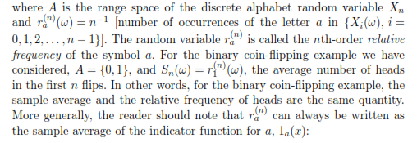

Slide 69
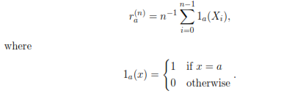

Slide 70
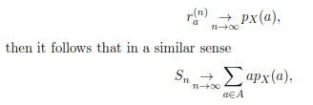
Law of large numbers
To continue the example of binary coin-flipping, the relative frequency of heads in n tosses of a fair coin should tend to 1/2 as n → ∞. If these statements are true,
that is, if in some sense, pmf is px

Slide 71
Expectation

Slide 72
a diﬀerent formula for ﬁnding the expectation in terms of the original probability function:

Slide 73
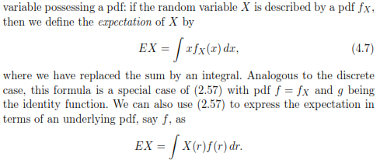

Slide 74
Summary

Slide 75
Examples

Slide 76
Examples

Slide 77
Examples

